Slide 1


Modeling active deformations in an elastic network using the Fast Inertial Relaxation Engine (FIRE) algorithm
Hins Qiu,
Abhinav Kumar, Kinjal Dasbiswas
Department of Physics

Slide 2
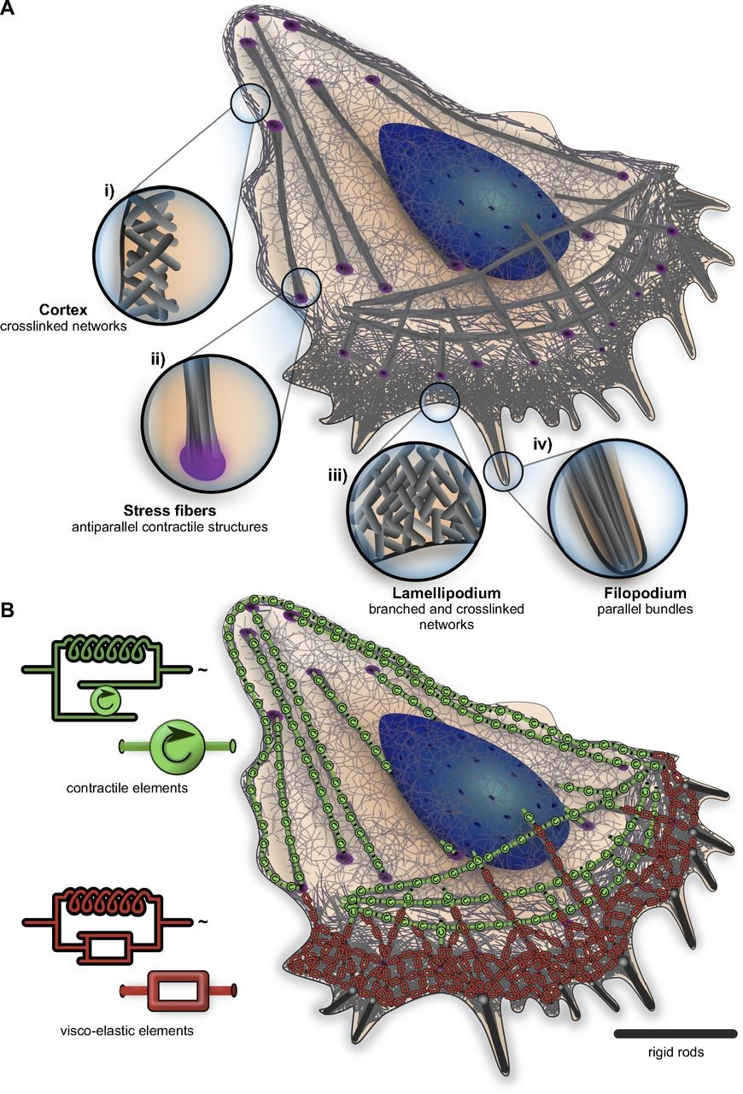
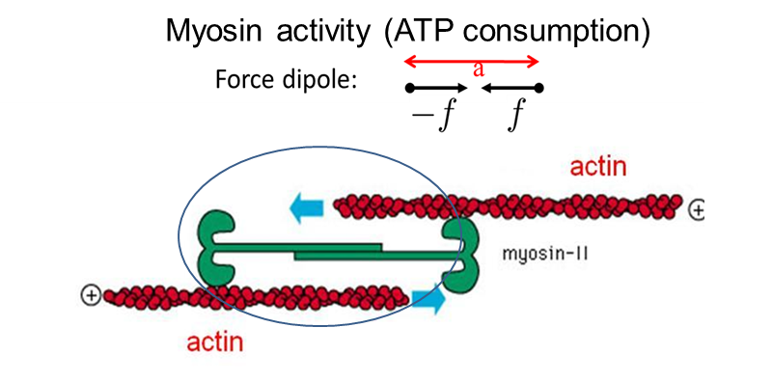
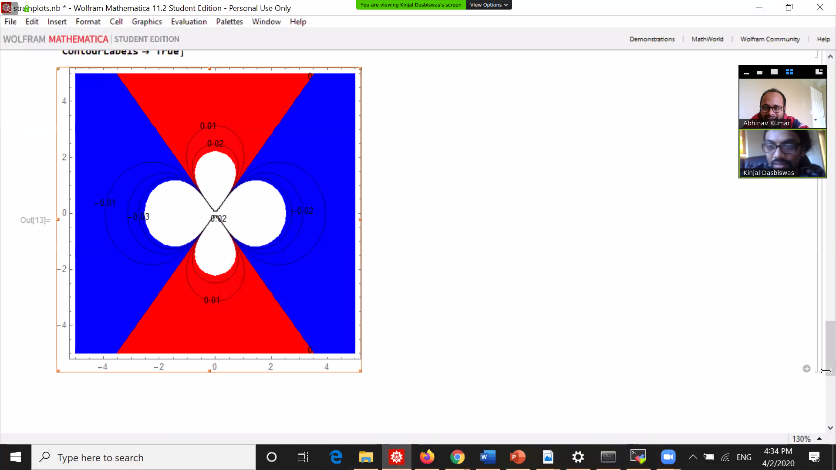
Structural order of myosin motors by mechanical forces
Stacking of myosin (green) in non-muscle cells (Bershadsky Lab)
Continuum linear elasticity: component of strain due to a force dipole along x axis.
Extensile regions (blue) and compressed regions (red)
Blanchoin et al. J. Physiol. Rev. 2014
Cell cytoskeleton: a biopolymer network that provides structural support and generates mechanical forces
comprises stable elastic structures like networks and bundles of the biopolymer actin
Questions : How does force propagate in disordered networks?
How do they form an ordered structure from a disordered network?
Hypothesis: Contractility of a fiber network depends on complex force transmisson and nonlinear multi-motor interactions
Notes:
How do force propagates in these networks?
Main introduction: The cytoskeleton plays an important role in cells. Many cell functions such as cellular motility, cytoplasmic streaming and organelle transport.
Fig 1. Experimental results showing ordered structure of acto-myosin network in non-muscle cells. It was found in the experiment that molecular motor forces were crucial in this stacking.
Fig 2.Myosin motors exert forces by sliding acting according to polarity
These forces generated by myosin are crucial for the ordering seen in experimental figure

Slide 3

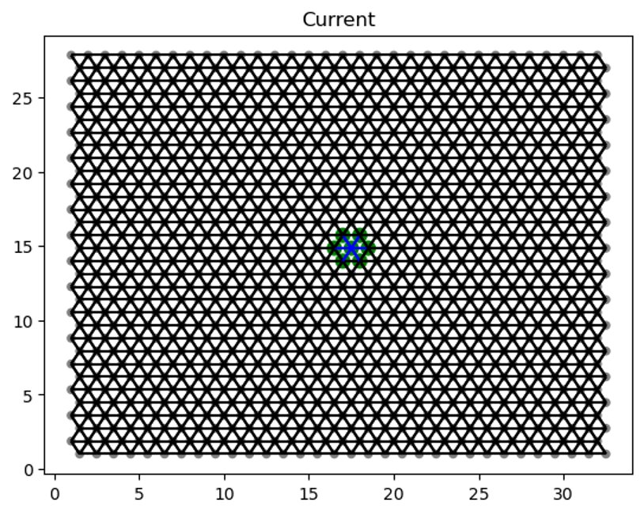
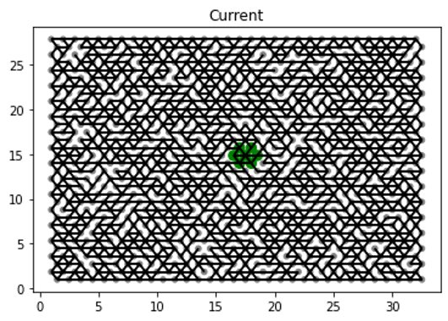
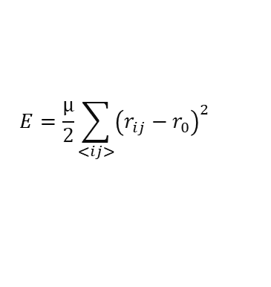
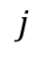
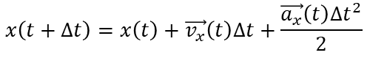

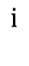
Model for mechanical deformations in the cytoskeletal network
Simulate fiber network using a triangular lattice
Free and fixed boundary conditions
Bonds represent actin fibers that can compress and stretch
Isotropic Force dipoles simulate myosin II motors
FIRE method integrated with velocity-verlet to minimize the total energy
$$j$$
Stretch
$$ⅈ$$
Compress
Stretching E (E_{s})
$$E=\frac{μ}{2}\sum_{<ij>}{{\left(r_{ij}−r_{0}\right)}^{2}}$$
P=1
P=0.7
Velocity-verlet (molecular dynamics)
$$x\left(t+Δt\right)=x\left(t\right)+\vec{v_{x}}\left(t\right)Δt+\frac{\vec{a_{x}}\left(t\right)Δt^{2}}{2}$$
$$\vec{v_{x}}\left(t+Δt\right)=\vec{v_{x}}\left(t\right)+\vec{F_{x}}\left(t\right)Δt$$
Notes:
Unit bond length = 1
Also write and talk about removing bonds here. Introduce pbond here. Maybe two pictures: full network and diluted network
Add ijk to theta in the hamiltonian. Can remove scale from x and y axis of the network - crop them

Slide 4
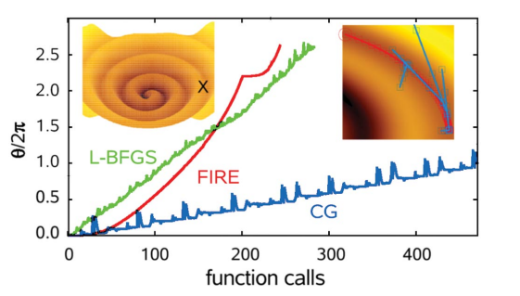
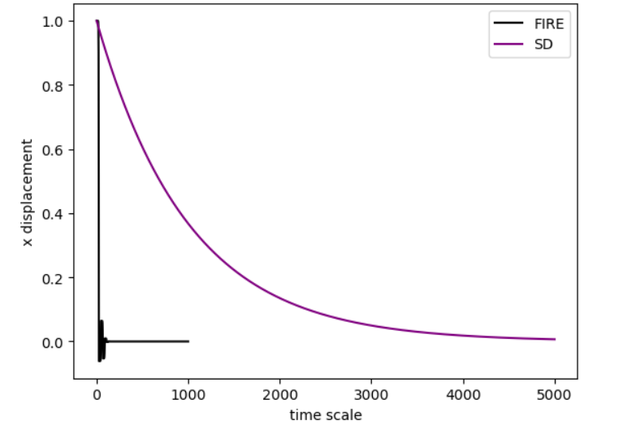
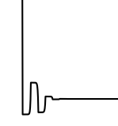
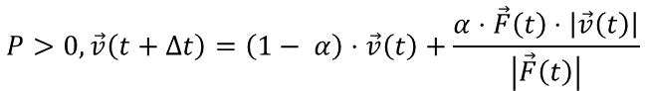
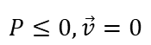
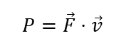
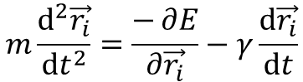
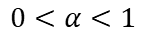
FIRE : an efficient method to find minima in complex energy landscapes
X displacement
Erik Bitzek, Pekka Koskinen, etc, Structural Relaxation Made Simple(Phys.Rev 2006)​
Time Scale
FIRE
Steepest descent (SD)
$$P=\vec{F}⋅\vec{v}$$
$$P≤0,\vec{v}=0$$
$$P>0,\vec{v}\left(t+Δt\right)=\left(1− α\right)⋅\vec{v}\left(t\right)+\frac{α⋅\vec{F}\left(t\right)⋅\left|\vec{v}\left(t\right)\right|}{\left|\vec{F}\left(t\right)\right|}$$
acceleration
elastic force
friction
$$m\frac{ⅆ^{2}\vec{r_{i}}}{ⅆt^{2}}=\frac{−∂E}{∂\vec{r_{i}}}−γ\frac{ⅆ\vec{r_{i}}}{ⅆt}$$
$$0<α<1$$
Notes:
Limited memory Broyden-Fletcher Goldfarb-Shanno (L-BFGS) Optimization of a spiral-shaped potential energy function
Steepest descent

Slide 5
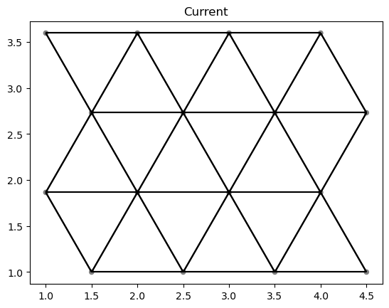
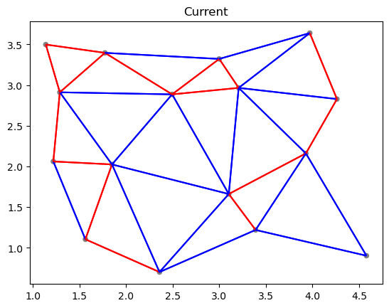
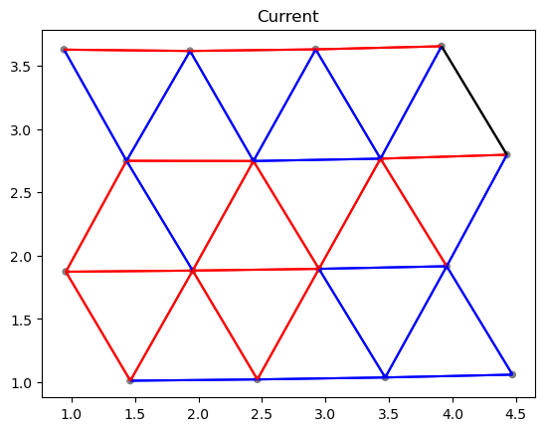
Testing FIRE with random node displacement
4x4 network approaches original structure after random displacement
initialization
Random displacements
relaxation
Notes:
To test FIRE, we started with a 4x4 network fire is pretty successful in this case. It's almost identical to how we started.

Slide 6
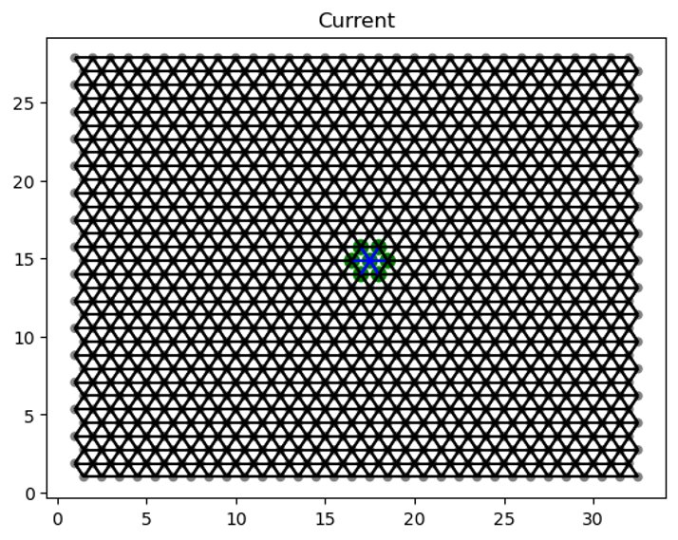
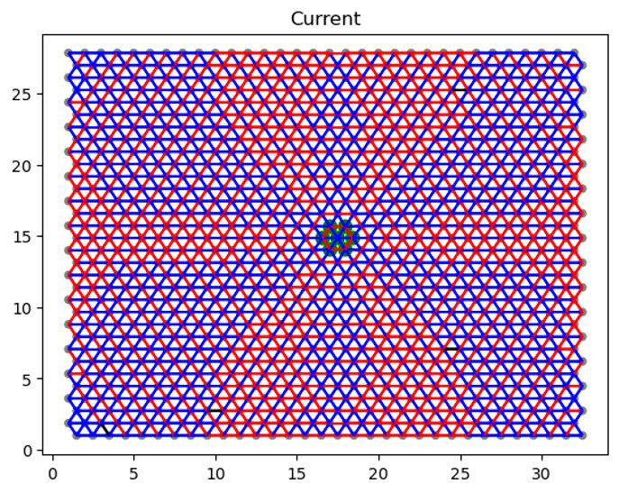
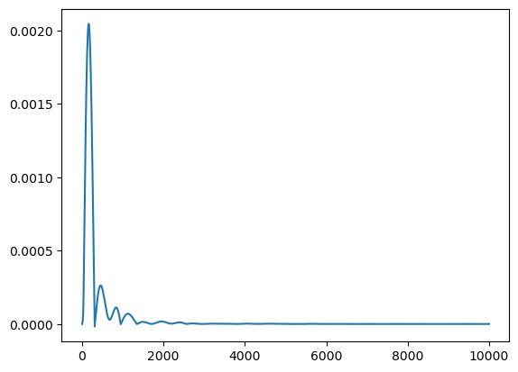
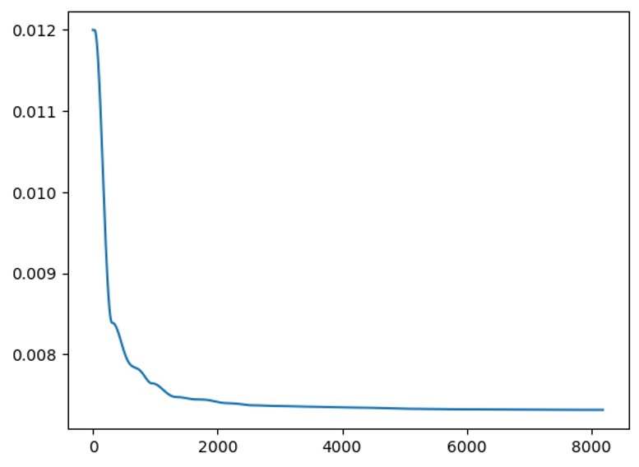
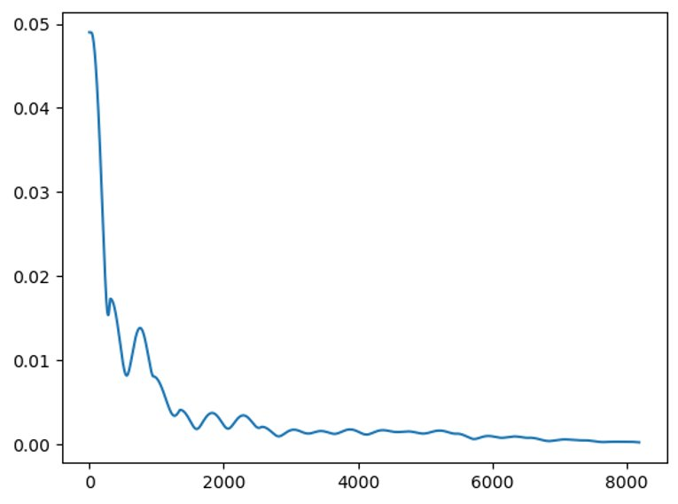
One-dipole spring network deforms to energy minima
Blue is stretch, red is compress.
Initial network
Final network
Power
Potential energy
Total force magnitude​
Time step
Time step
Time step
Notes:
Radial is stretched, transverse is compressed. All demonstrate some oscillations before stabilizing in minimum energy.

Slide 7
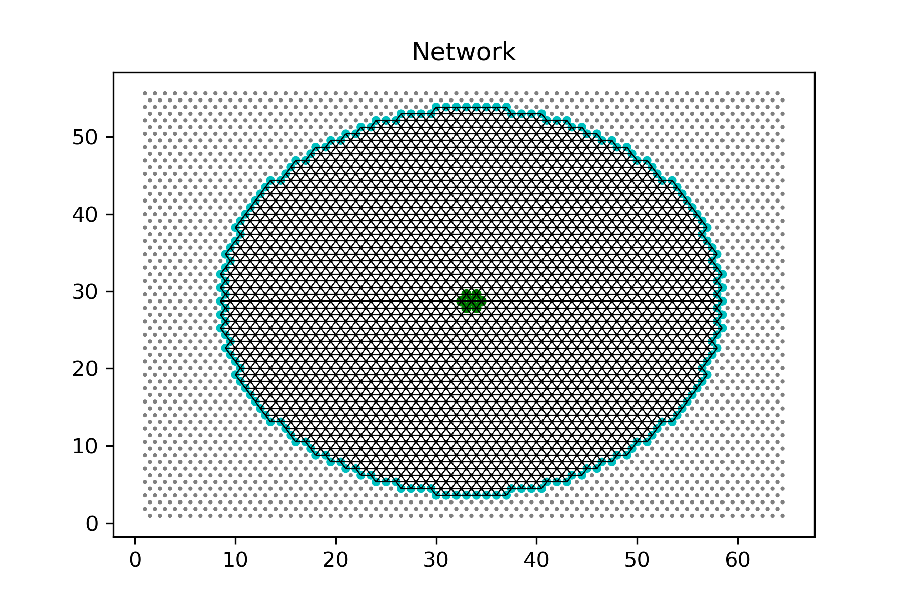
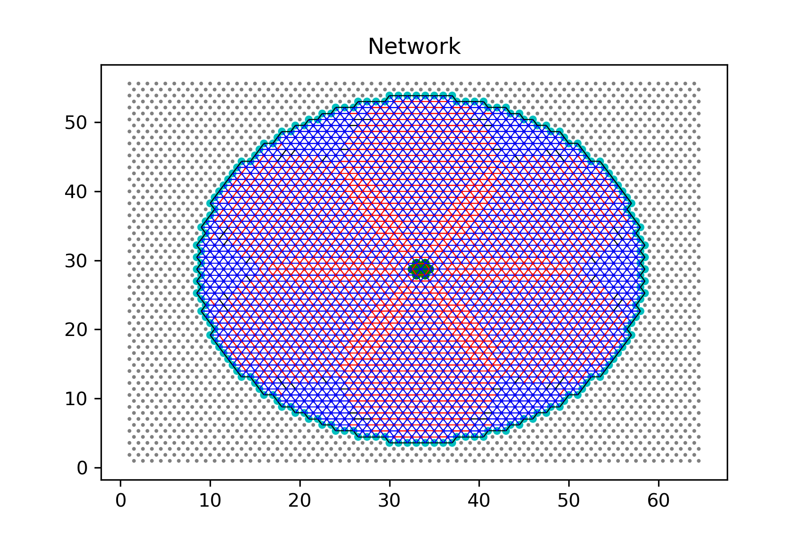
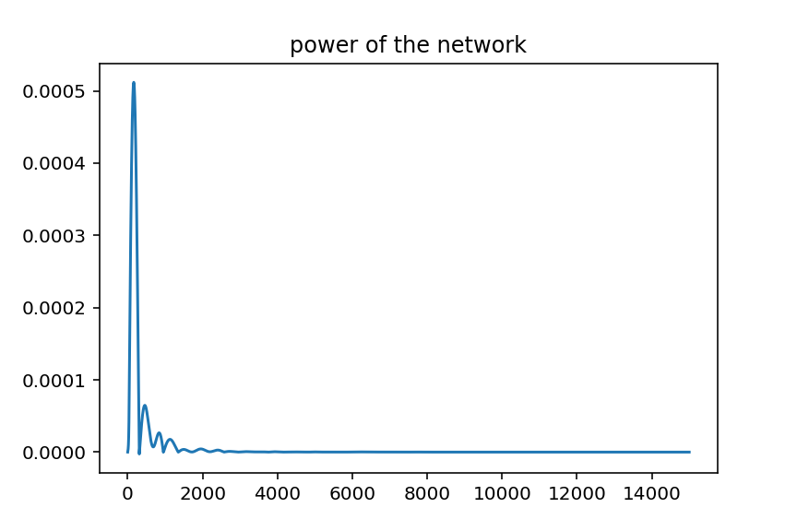
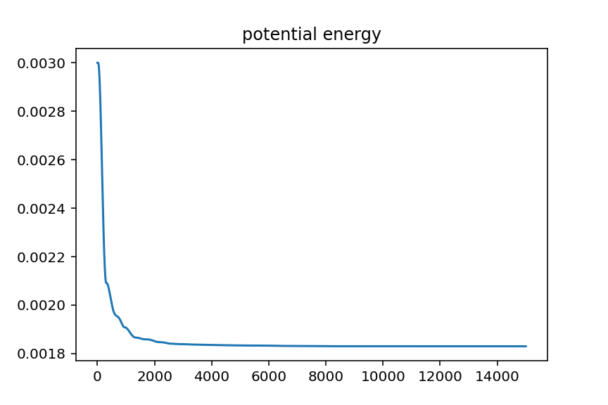
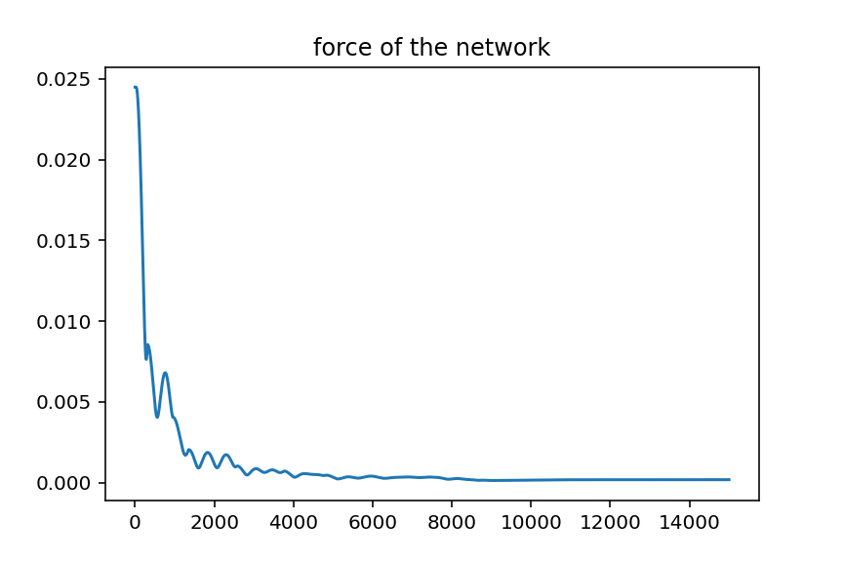
One-dipole circular spring network deforms to energy minima
Blue is stretch, red is compress.
Initial network
Final network
Time step
Time step
Time step
Notes:
Fixed boundary to measure the contraction force of the network.

Slide 8
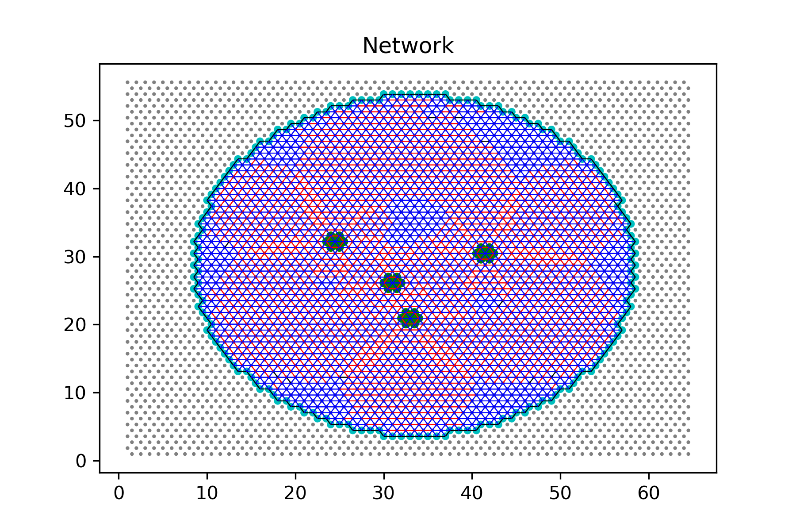
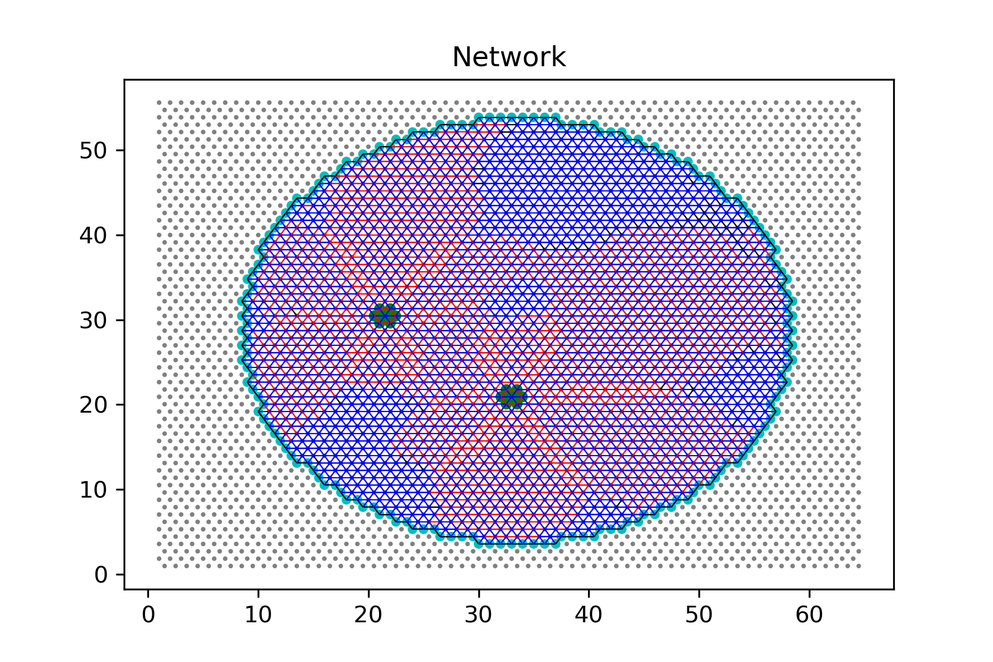
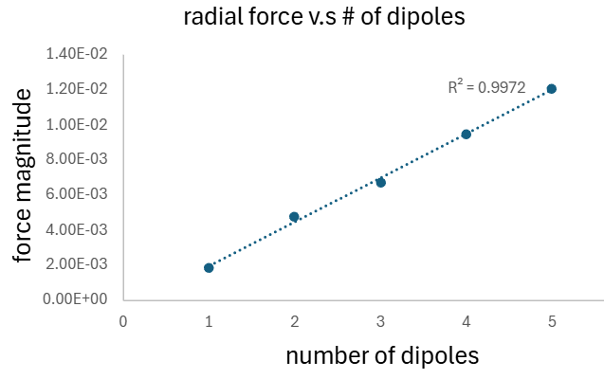
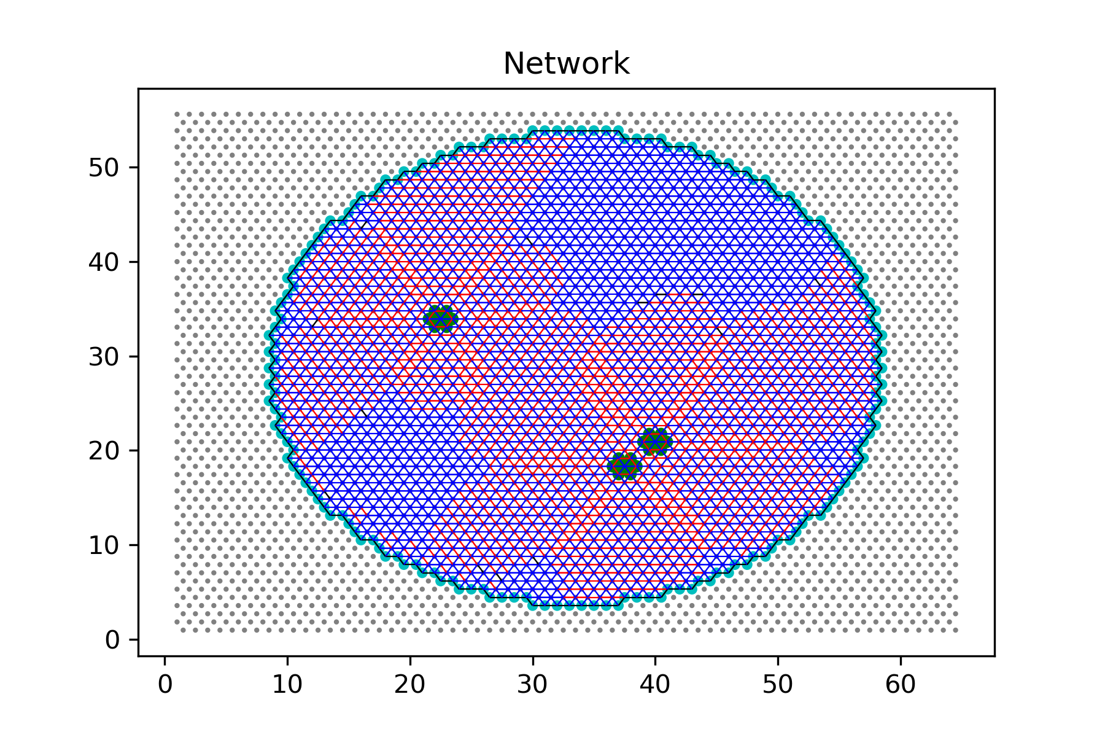
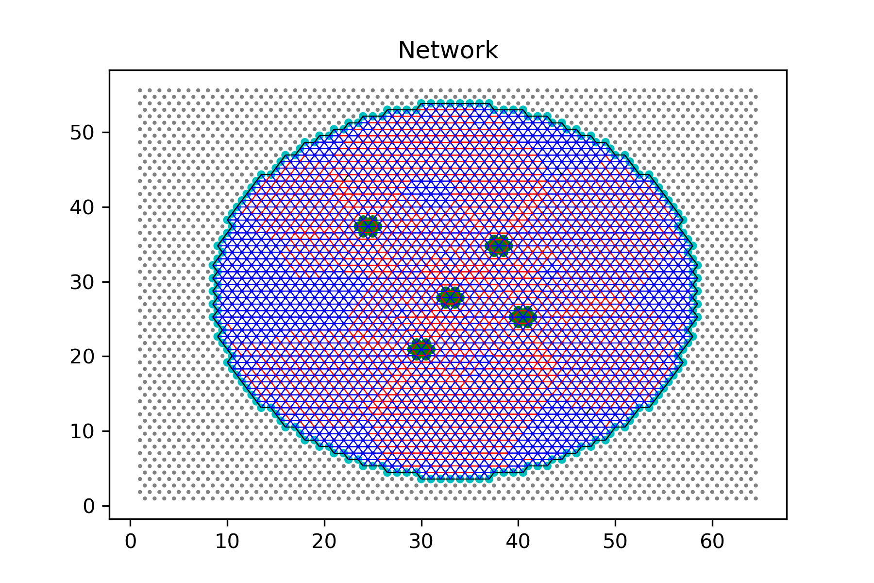
Network boundary force increases with number of dipoles following Gauss’s law for mechanics
“Gauss’s law” for mechanics: Contractile boundary force depends linearly on number of force dipoles, is independent of dipole positions

Slide 9
Conclusion and future goals
Around the springs, stretched springs are radially distributed while compressed springs are transversely distributed.
FIRE algorithm is comparatively simpler compared to the other methods.
Randomly remove bonds to create a disordered network that represents biological fiber networks

Slide 10
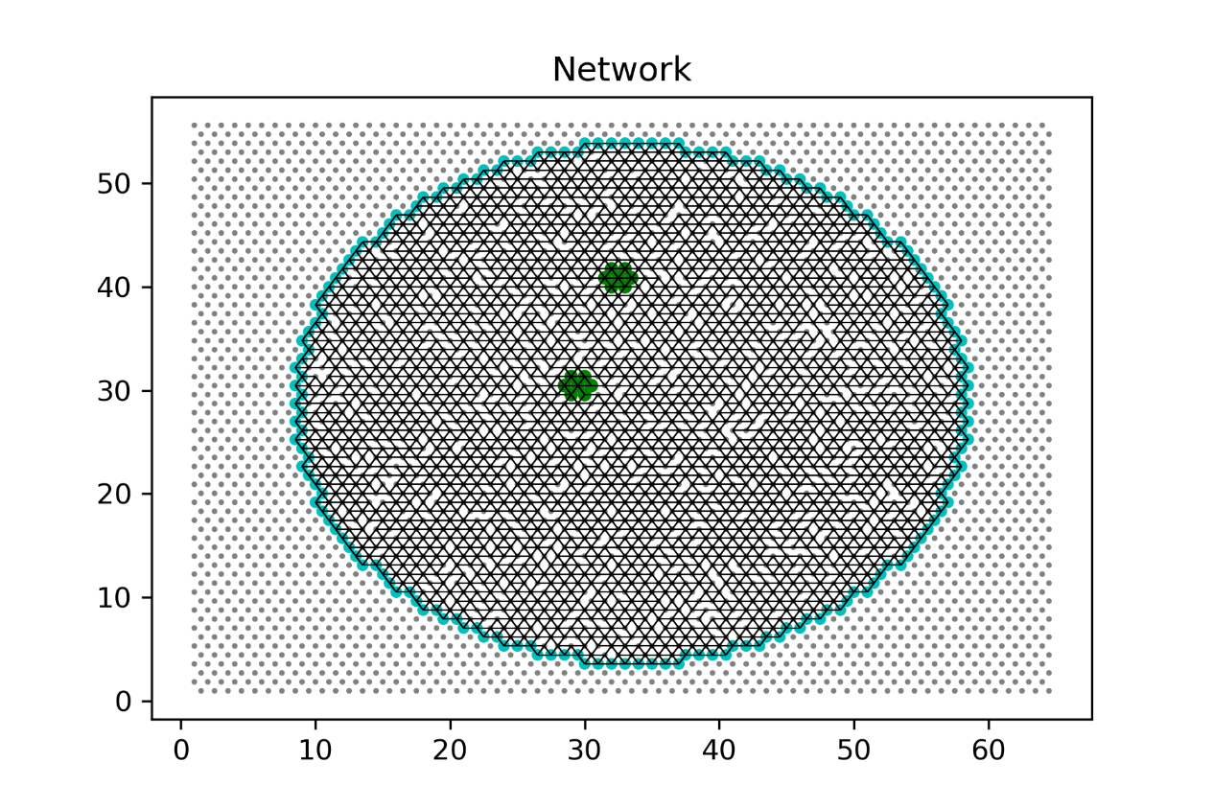
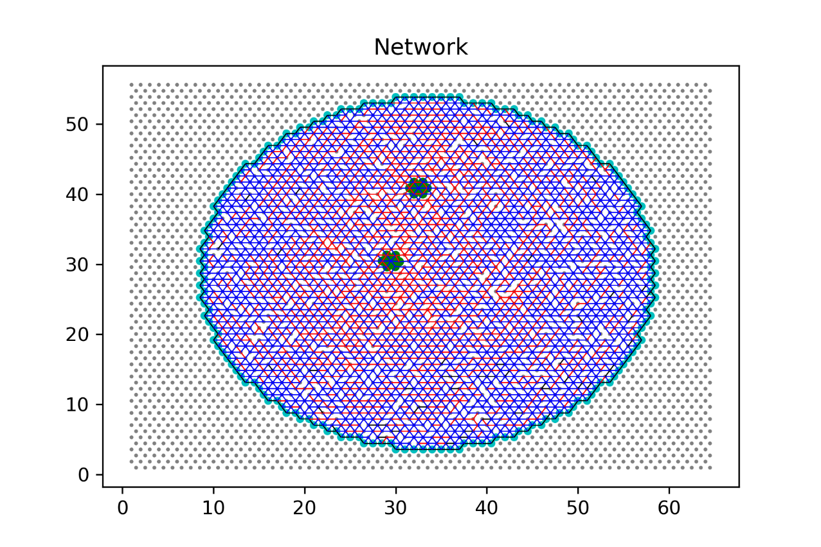
Network with springs removed P=0.9
Blue is stretch, red is compress.
Initial network
final network

Slide 11





Acknowledgement
Abhinav Kumar
Kinjal Dasbiswas
Notes:
This material is based upon work supported by the National Science Foundation under Grant No. 2150531

